Slide 1
Group Project Group 18
Jack fuller
Ionuț ciobanu

Slide 2



Logline
Beat your opponent by destroying the blocks beneath you to get to the bottom of the screen before them.
2 players
mobile
turn based

Slide 3
Target audience
Age:
15 – 30
Gender:
Both males and females
Casual gamers

Slide 4
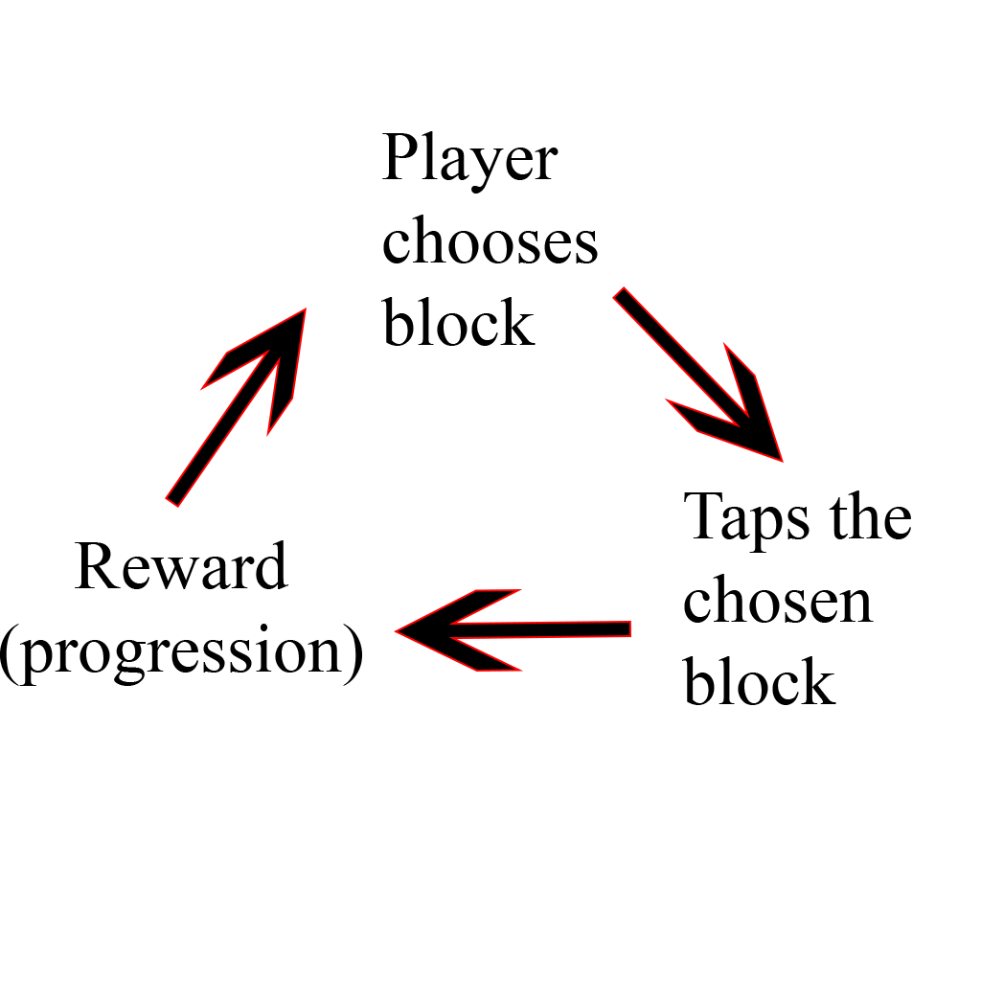
Core loop

Slide 5
Feedback
The score system wouldn’t make sense as the whole point of the game is to get to the bottom first.
Most of the players had no idea how the game works or what the combinations are respectively
The player starting the first had an advantage over the second player as he would be ahead from the beginning (closer to the bottom).

Slide 6
Iterations
The score system was removed as it wouldn’t have had any impact on the overall outcome of the game.
Instruction screen presenting the available combinations was added => the players now had a rough idea about how the game should be played.
Player 2 gets to start one row closer to the bottom in order to eliminate the handicap caused by the turn taking system.

Slide 7
Game features

Slide 8
